Slide 1

ESE 4009 IoT based Cradle system using SIDS monitor
Interfacing Raspberry Pi with GSM
INSTRUCTOR: Prof. Mike Aleshams
Group 6

Slide 2
Group 6
Group members:-
Presented by:-
Rohan Yadav | C0773871
Shahrukh Padaniya | C0769542
Swapnil Sevak | C0777195
Vandana Eaga | C0777215
Shahrukh Padaniya​ | C0769542​

Slide 3
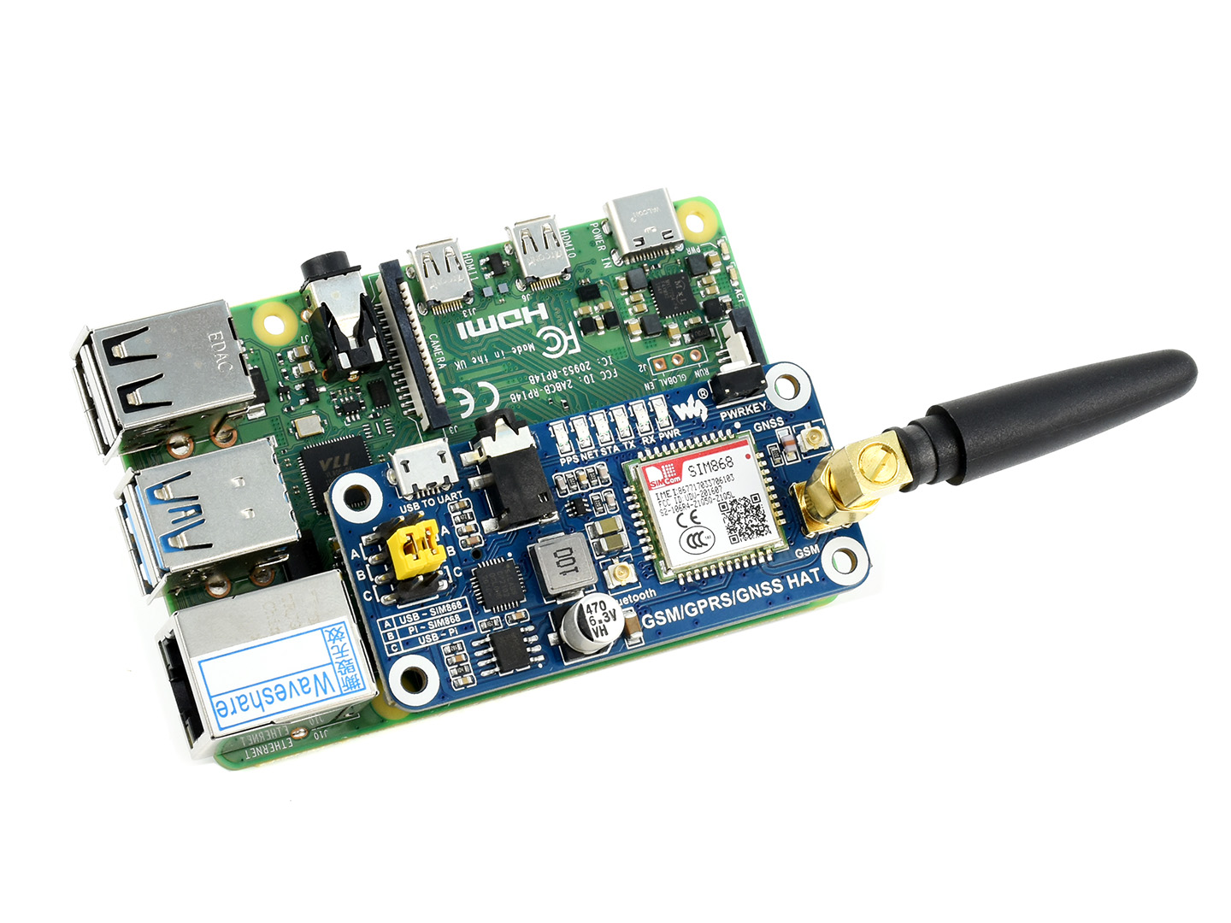
GSM Module:- SIM868
SIM868 is a handy, low power Raspberry Pi HAT which features multi communication functionalities: GSM, GPRS, GNSS and Bluetooth.
It allows your Pi to easily make a telephone call, send messages, connect to wireless Internet, global position, transfer data via Bluetooth, and so on.

Slide 4
GSM module General specification :-
Standard Raspberry Pi 40PIN GPIO extension header, supports Raspberry Pi series boards
Supports SMS, phone call, GPRS, DTMF, HTTP, FTP, MMS, email, etc.
Support GPS, COMPASS, Glonass, LBS base station positioning, omni-positioning
Bluetooth 3.0, supports data transferring through Bluetooth
Onboard USB TO UART converter CP2102 for UART debugging

Slide 5
GSM module General specification :-
6x LEDs for indicating the module working status
SIM card slot for 1.8V/3V SIM card
RTC with backup battery holder
Baud rate auto detection (1200bps ~115200bps)
Control via AT commands (3GPP TS 27.007, 27.005, and SIMCOM enhanced AT Commands)
Supports SIM application toolkit: GSM 11.14 Release 99

Slide 6
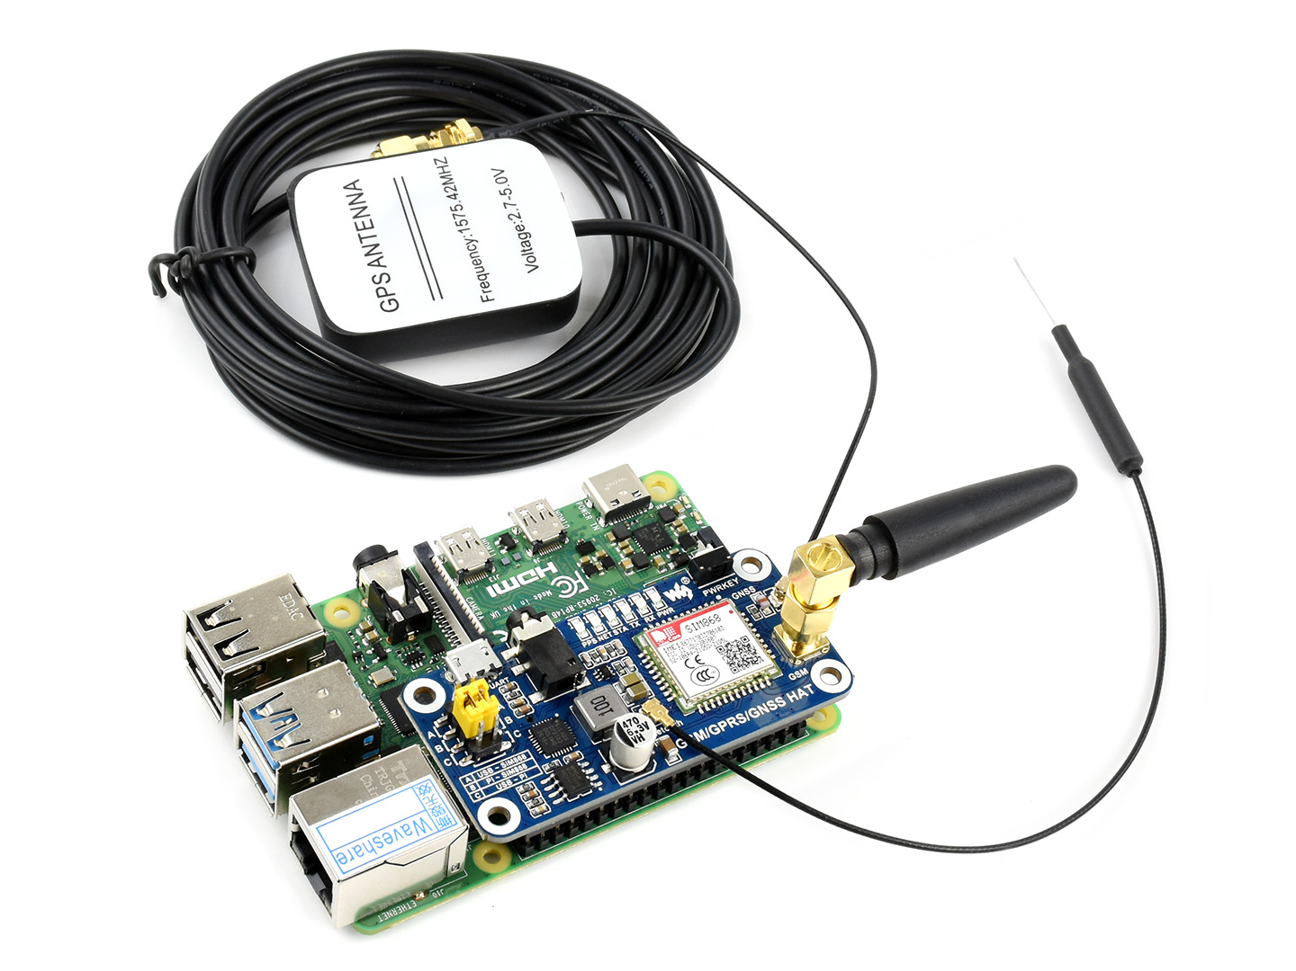
GSM module specification :-
Band
GSM 850/EGSM 900/DCS 1800/PCS 1900 MHz
Quad-band auto search
Compliant to GSM phase 2/2+

Slide 7
GSM module specification :-
GPRS connectivity
GPRS multi-slot class 12 (default)
GPRS multi-slot class 1~12 (configurable)
GPRS data feature
Downlink speed: max 85.6kbps
Uplink speed: max 85.6kbps
Coding schemes: CS-1\CS-2\CS-3\CS-4
Supports PAP (Password Authentication Protocol) for PPP connection
Supports PBCCH
Supports USSD

Slide 8
GSM module specification :-
SMS
Supports:
MT (“mobile terminated”)
MO (Mobile Originated)
CB (Cell Broadcast)
Text
PDU mode (Protocol Data Unit)
SMS storage: SIM card

Slide 9
Service provider compatible with SIM868
All service provider which uses GSM 850/EGSM 900/DCS 1800/PCS 1900 MHz frequency for GSM are compatible with SIM868. Some of them are listed below:-
Fido
Rogers
Airtel India

Slide 10
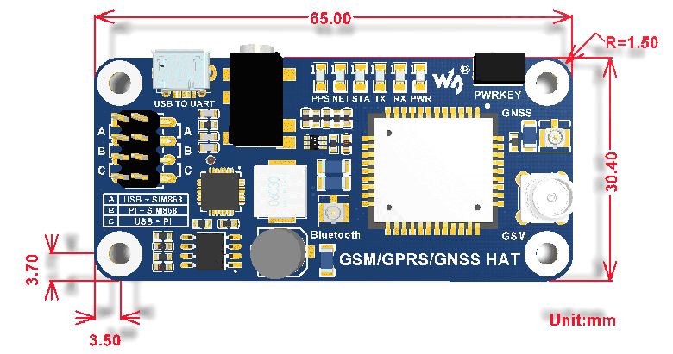
GSM module specification :-
Operating voltage: 5V
Operating temperature: -40°C ~ 85°C
Storage temperature: -45°C ~ 90°C
Dimensions: 30.4mm x 65mm

Slide 11
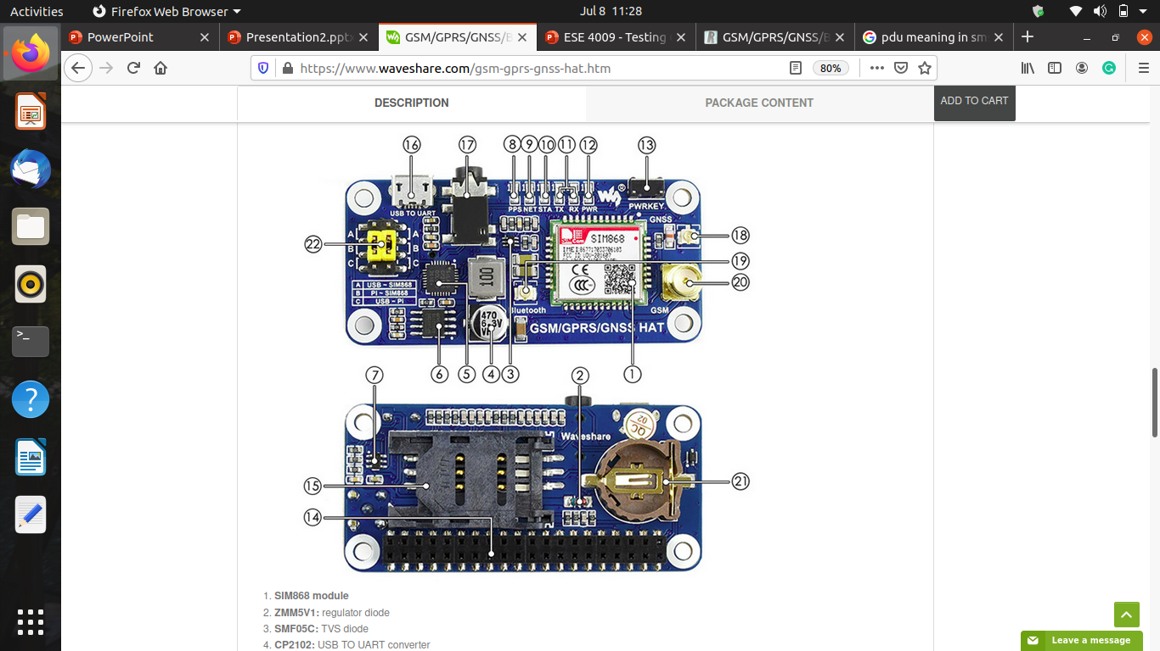
What's On Board :-

Slide 12
What's On Board :-
SIM868 module
ZMM5V1: regulator diode
SMF05C: TVS diode
CP2102: USB TO UART converter
MP1482: power chip
NDC7002N: voltage level translator
GPS status indicator
NET indicator:
flashes fast when the module starts up
flashes slowly after GSM register succeed
STA module working status indicator

Slide 13
What's On Board :-
10. SIM868 UART Tx/Rx indicator
11. Power indicator
12. SIM868 control button: press the button and hold for 1s, to startup/shutdown the SIM868
13. Raspberry Pi GPIO connector
14. SIM card slot
15. USB TO UART interface
16. 3.5mm earphone/mic jack
17. GNSS antenna connector
18. Bluetooth antenna connector
19. GSM antenna connector
20. CR1220 battery holder: for RTC backup battery
21. UART selection switch
A: control the SIM868 through USB TO UART
B: control the SIM868 through Raspberry Pi
C: access Raspberry Pi through USB TO UART

Slide 14
Interfacing SIM868 With Raspberry Pi 3
There are two ways for making the connections.
USB interfacing
GPIO interfacing
Here we make use of a micro USB cable for connecting Raspberry Pi with the HAT module that in-turn provides the suitable power and establish a serial communication.

Slide 15
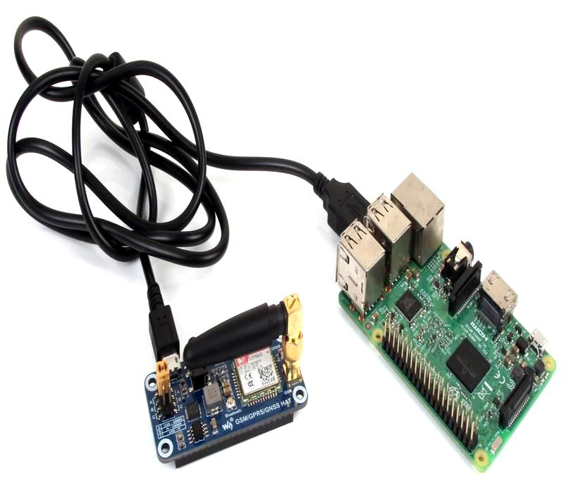
Interfacing SIM868 With Raspberry Pi 3​

Slide 16
Interfacing SIM868 With Raspberry Pi 3
SIM 868 module is being used in this device which is a complete Quad-Band GSM/GPRS module which combines GNSS technology for satellite navigation. In the left side of the module you can see a yellow jumper connected to the suitable pins. There are four pairs of pins in which the jumpers must be shorted to make three terminal pairs (A,B,C).
A: control the SIM868 through USB TO UART
B: control the SIM868 through Raspberry Pi
C: access Raspberry Pi through USB TO UART

Slide 17
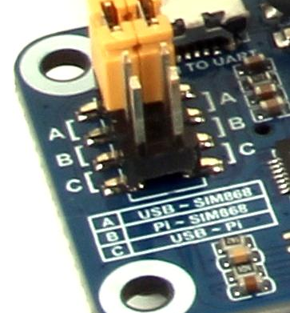
Interfacing SIM868 With Raspberry Pi 3
Here we make use of A terminal, i.e. the jumpers must be connected vertically in the first two pins as shown in the figure.

Slide 18
Interfacing SIM868 With Raspberry Pi 3
Power on the raspberry pi module with Raspbian OS installed on it. Connect the hat module to the raspberry pi through USB as shown in the first figure.
Insert a sim card to the HAT module to perform GSM operations.
After connecting the USB, the power led will be in an on state. Press the PWRKEY for 3 seconds and remove it. The STA LED (status) will also be in on state.
The NET led will blink in a continuous manner and the after obtaining the range for sim card, the blinking rate will be reduced.

Slide 19
AT command syntax:-
The "AT" or "at" or “aT” or “At” prefix must be set at the beginning of each Command line. To terminate a Command line enter <CR>. Commands are usually followed by a response that includes. "<CR><LF><response><CR><LF>" Throughout this document, only the responses are presented, <CR><LF> are omitted intentionally.

Slide 20
Basic syntax for AT commands:-
These AT commands have the format of "AT<x><n>", or "AT&<x><n>", where "<x>"is the Command, and "<n>"is/are the argument(s) for that Command. An example of this is "AT E<n>", which tells the DCE whether received characters should be echoed back to the DTE according to the value of "<n>". "<n>" is optional and a default will be used if missing.

Slide 21
AT Commands :-
Command | Description
A/ | Re-issues the last command given
ATA | Answer an incoming call
ATD | Mobile originated call to dial a number
ATDL | Redial last telephone number used

Slide 22
AT Commands :-
Demonstration | Syntax | Expect Result
Set SMS system into text mode, as opposed to PDU mode. | AT + C M G F = 1 | OK
Send an SMS to myself. | AT+CSCS="GSM" AT+CMGS="+861391818xxxx" >This is a test <Ctrl+Z> | OK +CMGS:34 OK
Read SMS message that has just arrived.Note: the number should be the same as that given in the +CMTI notification | AT + CMGR = 1 | +CMGR: "REC UNREAD","+16477872530", "","08 /07/21,20:40:31+00" This is a test OK

Slide 23
AT Commands :-
Demonstration ​ | Syntax​ | Expect Result ​
List all SMS messages.​ | AT+CMGL="ALL" ​ | +CMGL: 1, "REC READ","+16477872530", "", "08/07/21,20:40:31+00" ​ This is a test​ OK​
Delete an SMS message. | AT+CMGD=1 | OK

Slide 24
AT Commands :-
Demonstration ​ | Syntax​ | Expect Result ​
Make a voice call | ATD6477872530; | OK ​ MS makes a voice call
Hang up a call | ATH | OK Call dropped

Slide 25
AT Commands :-
Demonstration ​​ | Syntax​​ | Expect Result ​​
Display the current network operator that the handset is currently registered with. | AT + COPS? | +COPS: 0,0,"CHINA MOBILE" OK
Display a full list of network operator names. | AT+COPN | +COPN: "20201", "COSMO" [skip a bit] +COPN: "901012","Maritime Comm Partner AS" OK
​ | ​ | ​

Slide 26
Code
import serial import RPi.GPIO as GPIO import os, time GPIO.setmode(GPIO.BOARD) # Enable Serial Communication port = serial.Serial("/dev/ttyS0", baudrate=9600, timeout=1) # Transmitting AT Commands to the Modem # '\r\n' indicates the Enter key port.write('AT'+'\r\n') rcv = port.read(10) print rcv time.sleep(1)

Slide 27
Code:
port.write('ATE0'+'\r\n') # Disable the Echo rcv = port.read(10) print rcv time.sleep(1) port.write('AT+CMGF=1'+'\r\n') # Select Message format as Text mode rcv = port.read(10) print rcv time.sleep(1)
port.write('AT+CNMI=2,1,0,0,0'+'\r\n') # New SMS Message Indications rcv = port.read(10) print rcv time.sleep(1)

Slide 28
Code:
# Sending a message to a particular Number port.write('AT+CMGS="6477872530"'+'\r\n') rcv = port.read(10) print rcv time.sleep(1) port.write('Message Test 123'+'\r\n') # Message rcv = port.read(10) print rcv port.write("\x1A") # Enable to send SMS for i in range(10): rcv = port.read(10) print rcv

Slide 29
References:-
waveshare. (n.d.). GSM/GPRS/GNSS/Bluetooth HAT for Raspberry Pi. Waveshare. Retrived from - https://www.waveshare.com/gsm-gprs-gnss-hat.htm.
Mahesh. (2018, May 2). Raspberry Pi: rhydoLABZ-wiki. rhydoLABZwiki. Retrived from - https://www.rhydolabz.com/wiki/?cat=39.
SIM868 GSM/GPRS/GNSS/Bluetooth HAT for Raspberry Pi. DIYElectronics. (n.d.). https://www.diyelectronics.co.za/store/hats/1800-sim868-gsmgprsgnss-hat-for-raspberry-pi.html.
Check service provider frequency (n.d.) https://www.frequencycheck.com
https://www.waveshare.com/w/upload/2/20/SIM800_Series_AT_Command_Manual_V1.09.pdf

Slide 30

THANK YOU

